Slide 1



Slide 2


Slide 3
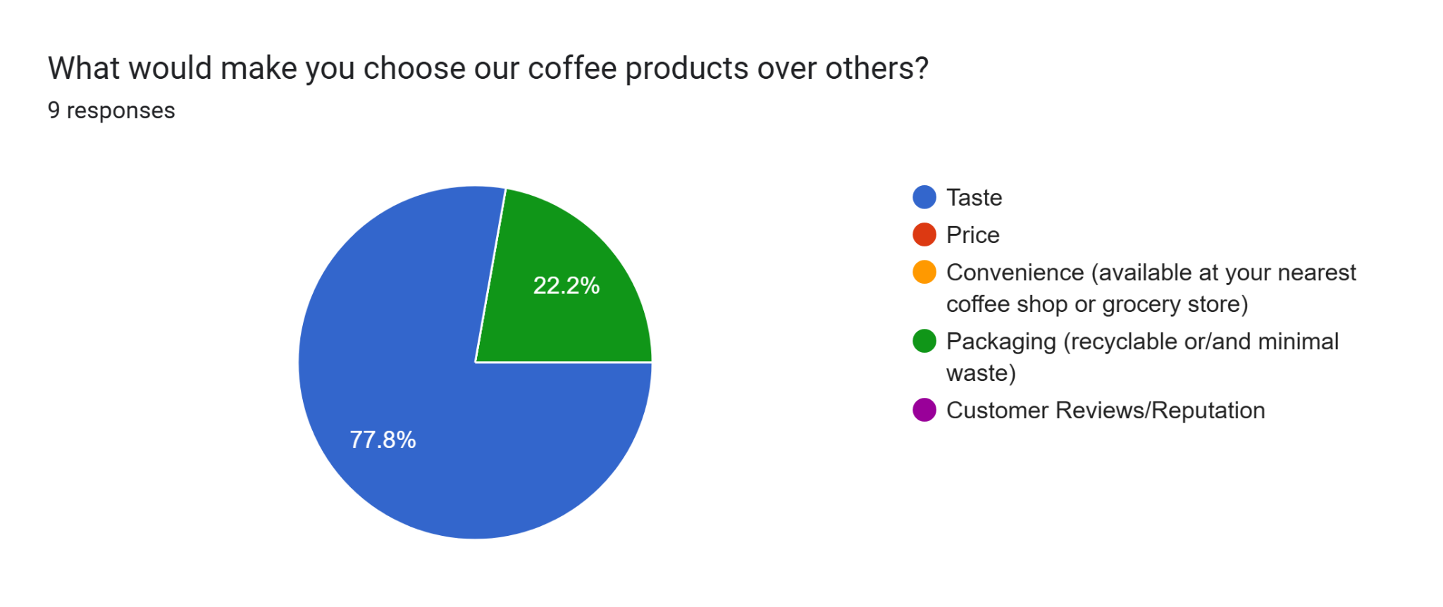

Slide 4

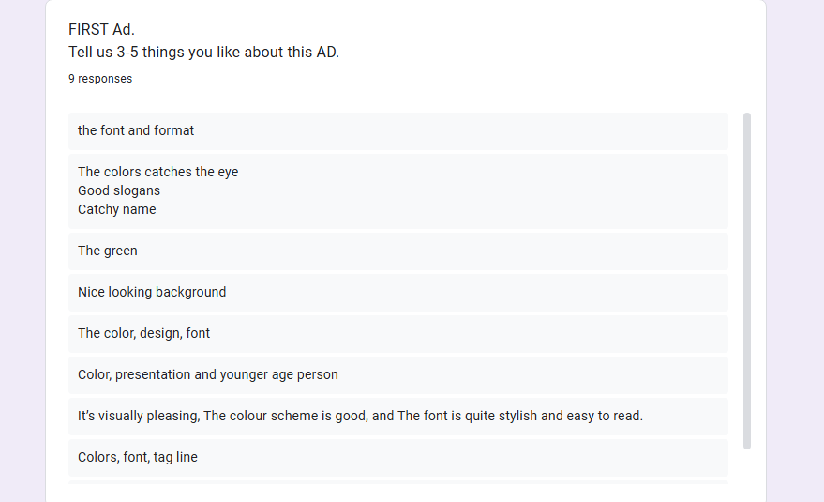

Slide 5
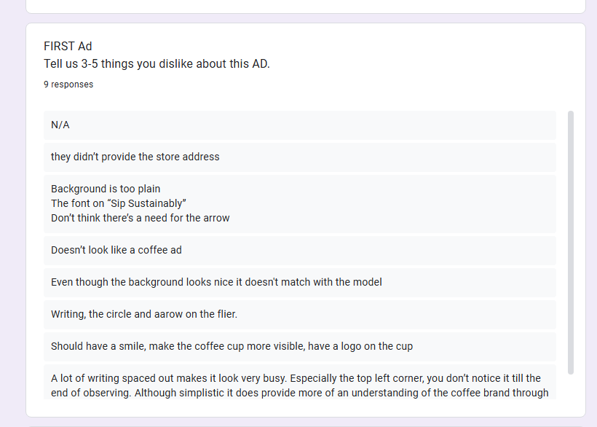

Slide 6

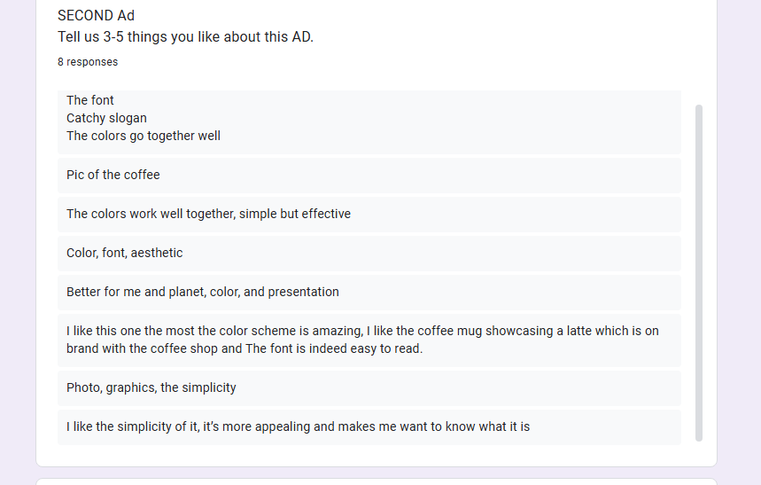

Slide 7
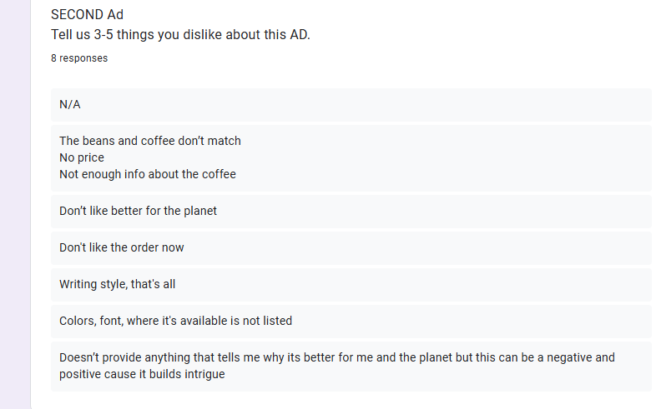

Slide 8
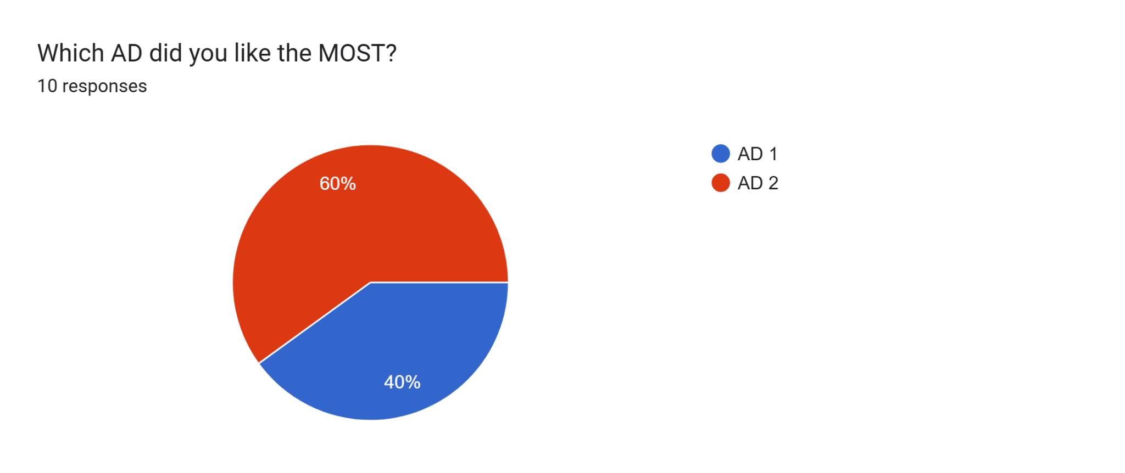

Slide 9
What is your age demographic?
20-30
20-30
20-30
20-30
20-30
80+
15-19
51-60
51-60
41-50
Do you drink coffee?
Sometimes
Yes
Sometimes
Yes
Yes
Sometimes
Sometimes
Yes
No
Yes

